Slide 1

Design and Analysis of Algorithms
Part I: Divide and Conquer
Lecture 4: Heapsort and Lower Bound for Sorting
Ke Xu and Yongxin Tong
(许可 与 童咏昕)
School of CSE, Beihang University

Slide 2
Outline
Introduction to Part I
Heapsort Problem
Priority Queues
(Binary) Heap
Heapsort
Lower Bound for Comparison-based Sorting
Objective
Decision Tree Model

Slide 3
Outline
Introduction to Part I
Heapsort Problem
Priority Queues
(Binary) Heap
Heapsort
Lower Bound for Comparison-based Sorting
Objective
Decision Tree Model

Slide 4
Introduction to Part I
In Part I, we will illustrate Divide-and-Conquer using several examples:
Maximum Contiguous Subarray (最大子数组)
Counting Inversions (逆序计数)
Polynomial Multiplication (多项式乘法)
QuickSort and Partition (快速排序与划分)
Lower Bound for Sorting (基于比较的排序下界)

Slide 5
Introduction to Part I
In Part I, we will illustrate Divide-and-Conquer using several examples:
Maximum Contiguous Subarray (最大子数组)
Counting Inversions (逆序计数)
Polynomial Multiplication (多项式乘法)
QuickSort and Partition (快速排序与划分)
Lower Bound for Sorting (基于比较的排序下界)

Slide 6
Outline
Introduction to Part I
Heapsort Problem
Priority Queues
(Binary) Heap
Heapsort
Lower Bound for Comparison-based Sorting
Objective
Decision Tree Model

Slide 7

Priority Queue: Motivating Example
3 jobs have been submitted to a printer in the order A, B, C. Consider the printing pool at this moment.
Sizes: Job A — 100 pages
Job B — 10 pages
Job C — 1 page

Slide 8
Priority Queue: Motivating Example
3 jobs have been submitted to a printer in the order A, B, C. Consider the printing pool at this moment.
Sizes: Job A — 100 pages
Job B — 10 pages
Job C — 1 page
Average finish time with FIFO service:
$$(100+110+111) / 3 = 107 time units$$

Slide 9
Priority Queue: Motivating Example
3 jobs have been submitted to a printer in the order A, B, C. Consider the printing pool at this moment.
Sizes: Job A — 100 pages
Job B — 10 pages
Job C — 1 page
Average finish time with FIFO service:
$$(100+110+111) / 3 = 107 time units$$
Average finish time for shortest-job-first service:
$$(1+11+111) / 3 = 41 time units$$

Slide 10
Priority Queue: Motivating Example
The elements in the queue are printing jobs, each with the associated number of pages that serves as its priority
Processing the shortest job first corresponds to extracting the smallest element from the queue
Insert new printing jobs as they arrive

Slide 11
Priority Queue: Motivating Example
The elements in the queue are printing jobs, each with the associated number of pages that serves as its priority
Processing the shortest job first corresponds to extracting the smallest element from the queue
Insert new printing jobs as they arrive
A queue is capable of supporting two operations: Insert and Extract-Min?

Slide 12
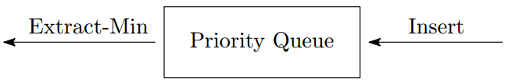
Priority Queue
Priority queue is an abstract data structure that supports two operations
Insert: inserts the new element into the queue
Extract-Min: removes and returns the smallest element from the queue

Slide 13
Possible Implementations
Unsorted list + a pointer to the smallest element
Insert in O(1) time
Extract-Min in O(n) time, since it requires a linear scan to find the new minimum

Slide 14
Possible Implementations
Unsorted list + a pointer to the smallest element
Insert in O(1) time
Extract-Min in O(n) time, since it requires a linear scan to find the new minimum
Sorted array
Insert in O(n) time
Extract-Min in O(1) time

Slide 15
Possible Implementations
Unsorted list + a pointer to the smallest element
Insert in O(1) time
Extract-Min in O(n) time, since it requires a linear scan to find the new minimum
Sorted array
Insert in O(n) time
Extract-Min in O(1) time
Sorted doubly linked list
Insert in O(n) time
Extract-Min in O(1) time

Slide 16
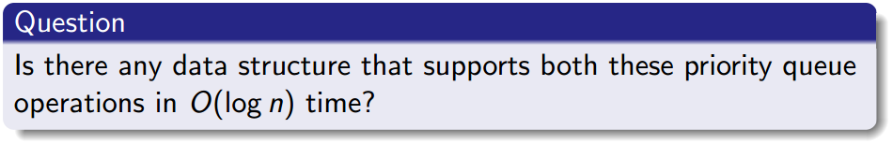
Possible Implementations
Unsorted list + a pointer to the smallest element
Insert in O(1) time
Extract-Min in O(n) time, since it requires a linear scan to find the new minimum
Sorted array
Insert in O(n) time
Extract-Min in O(1) time
Sorted doubly linked list
Insert in O(n) time
Extract-Min in O(1) time

Slide 17
Outline
Introduction to Part I
Heapsort Problem
Priority Queues
(Binary) Heap
Heapsort
Lower Bound for Comparison-based Sorting
Objective
Decision Tree Model

Slide 18
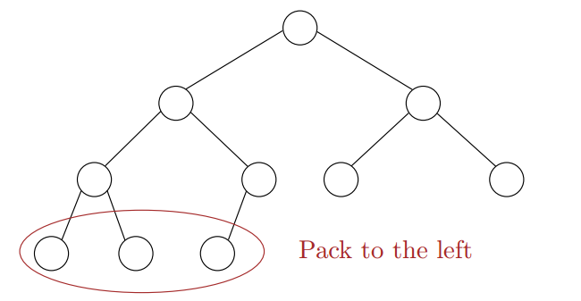
(Binary) Heap
Heaps are "almost complete binary trees"
All levels are full except possibly the lowest level.
If the lowest level is not full, then nodes must be packed to the left.

Slide 19
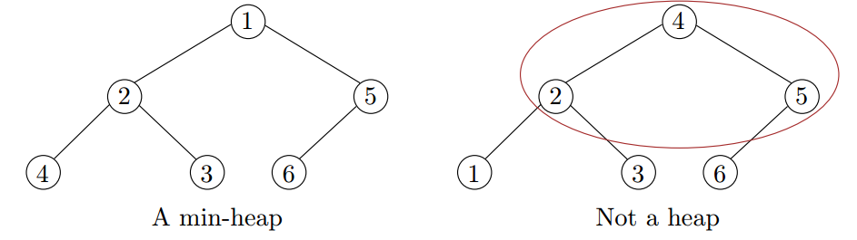
Heap-order Property
Heap-order property (Min-heap):
The value of a node is at least the value of its parent.
A[Parent(i)] ≤ A[i]

Slide 20
Heap Properties
If the heap-order property is maintained, heaps support the following operations efficiently (assume there are n elements in the heap)
Insert in O(log n) time
Extract-Min in O(log n) time

Slide 21
Heap Properties
If the heap-order property is maintained, heaps support the following operations efficiently (assume there are n elements in the heap)
Insert in O(log n) time
Extract-Min in O(log n) time
Structure properties
A heap of height h has between 2^{h} to 2^{h+1}−1 nodes. Thus, an n-element heap has height Θ(log n).

Slide 22
Heap Properties
If the heap-order property is maintained, heaps support the following operations efficiently (assume there are n elements in the heap)
Insert in O(log n) time
Extract-Min in O(log n) time
Structure properties
A heap of height h has between 2^{h} to 2^{h+1}−1 nodes. Thus, an n-element heap has height Θ(log n).
The structure is so regular, it can be represented in an array and no links are necessary !

Slide 23
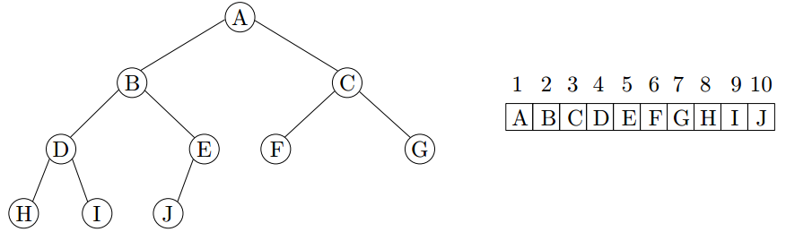
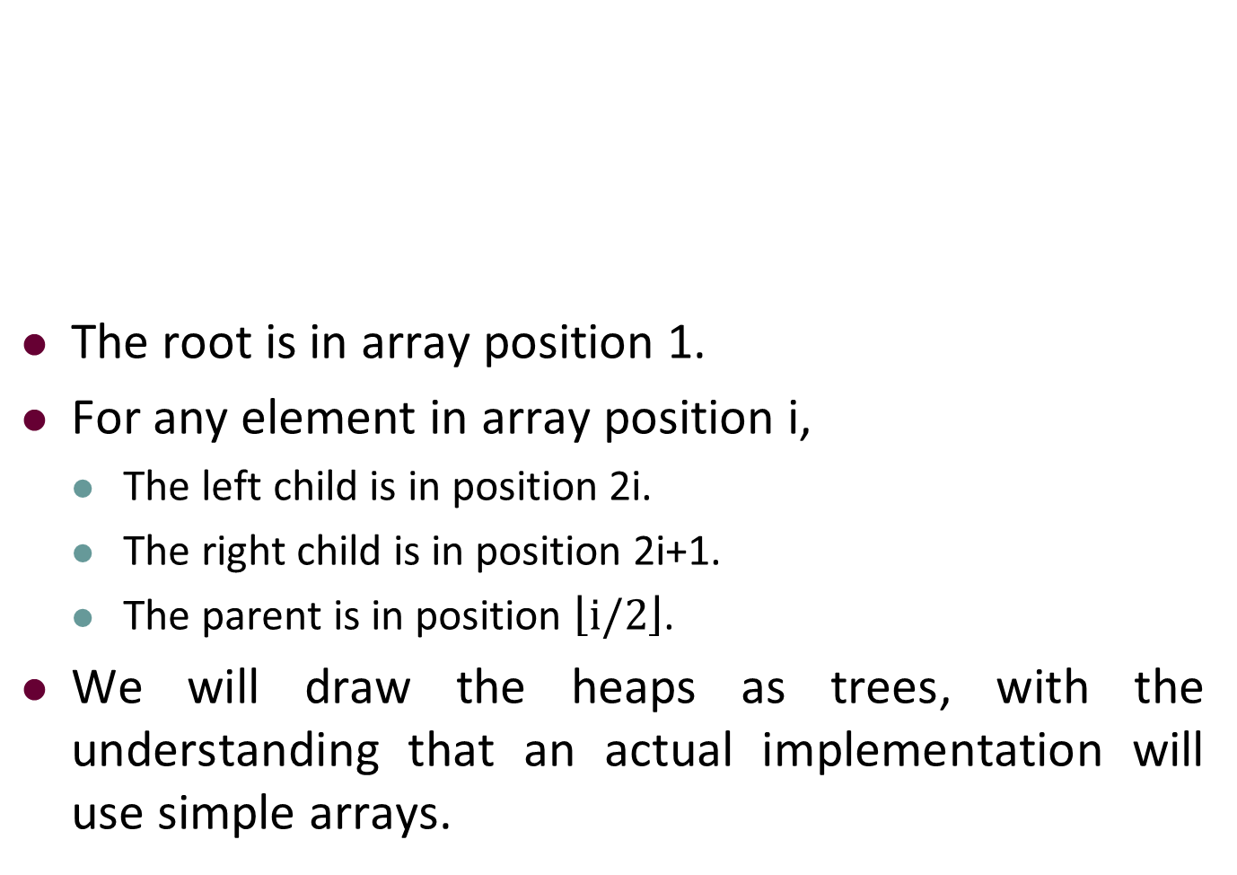
Array Implementation of Heap
The root is in array position 1.
For any element in array position i,
The left child is in position 2i.
The right child is in position 2i+1.
The parent is in position $\left\lfloor i/2\right\rfloor$.
We will draw the heaps as trees, with the understanding that an actual implementation will use simple arrays.

Slide 24
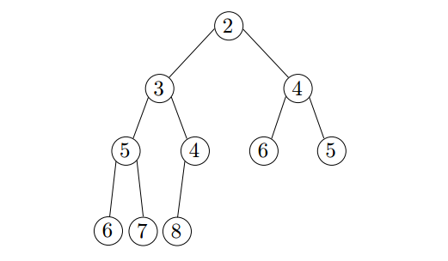
Insertion
Add the new element to the next available position at the lowest level
Restore the min-heap property if violated
General strategy is percolate up (or bubble up): if the parent of the element is larger than the element, then interchange the parent with child.

Slide 25
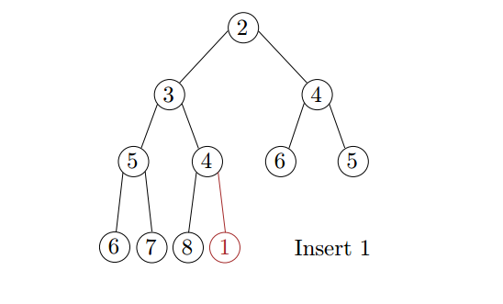
Insertion
Add the new element to the next available position at the lowest level
Restore the min-heap property if violated
General strategy is percolate up (or bubble up): if the parent of the element is larger than the element, then interchange the parent with child.

Slide 26
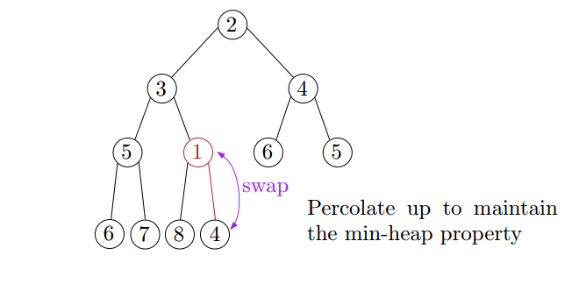
Insertion
Add the new element to the next available position at the lowest level
Restore the min-heap property if violated
General strategy is percolate up (or bubble up): if the parent of the element is larger than the element, then interchange the parent with child.

Slide 27
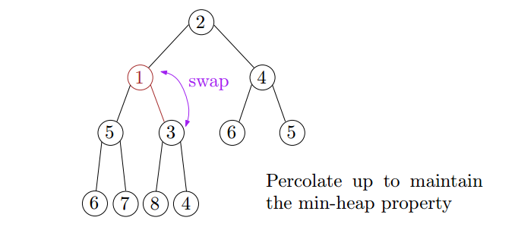
Insertion
Add the new element to the next available position at the lowest level
Restore the min-heap property if violated
General strategy is percolate up (or bubble up): if the parent of the element is larger than the element, then interchange the parent with child.

Slide 28
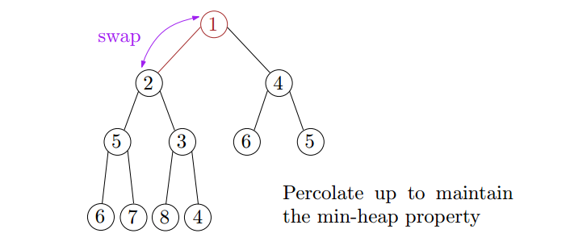
Insertion
Add the new element to the next available position at the lowest level
Restore the min-heap property if violated
General strategy is percolate up (or bubble up): if the parent of the element is larger than the element, then interchange the parent with child.
Correctness: after each swap, the min-heap property is satisfied for the subtree rooted at the new element

Slide 29
Insertion
Add the new element to the next available position at the lowest level
Restore the min-heap property if violated
General strategy is percolate up (or bubble up): if the parent of the element is larger than the element, then interchange the parent with child.
Correctness: after each swap, the min-heap property is satisfied for the subtree rooted at the new element
Time complexity = O(height) = O(log n)

Slide 30
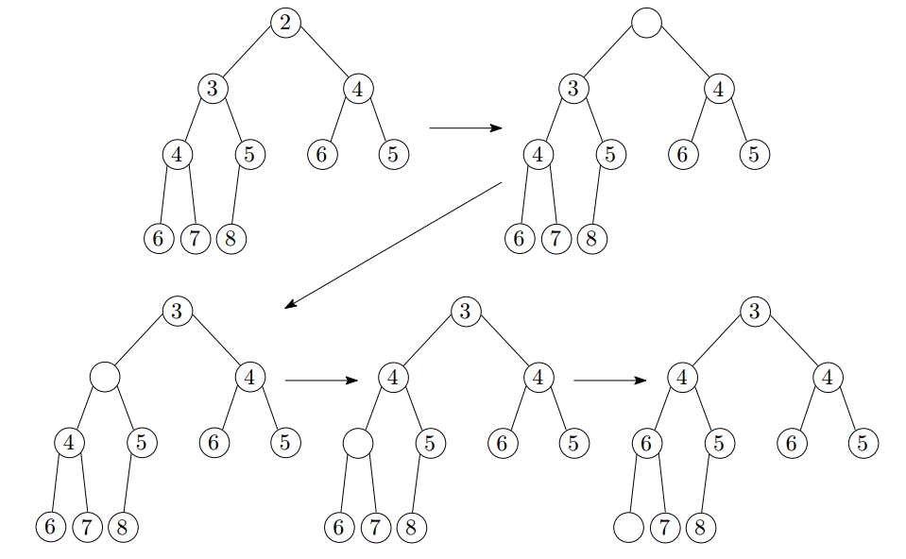
Extract-Min: First Attempt

Slide 31
Extract-Min: First Attempt
Min-heap property preserved, but completeness not preserved!

Slide 32
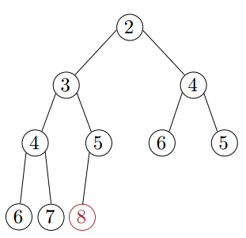
Extract-Min
Copy the last element to the root (i.e., overwrite the minimum element stored there)
Restore the min-heap property by percolate down (or bubble down): if the element is larger than either of its children, then interchange it with the smaller of its children.

Slide 33
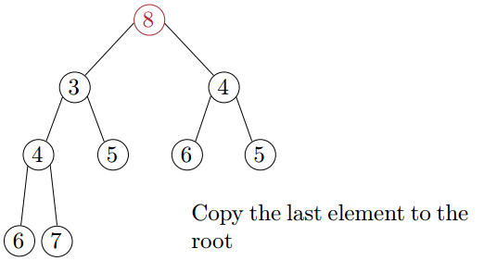
Extract-Min
Copy the last element to the root (i.e., overwrite the minimum element stored there)
Restore the min-heap property by percolate down (or bubble down): if the element is larger than either of its children, then interchange it with the smaller of its children.

Slide 34
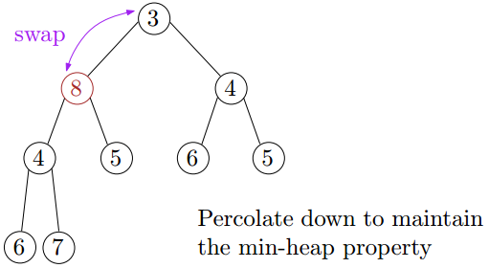
Extract-Min
Copy the last element to the root (i.e., overwrite the minimum element stored there)
Restore the min-heap property by percolate down (or bubble down): if the element is larger than either of its children, then interchange it with the smaller of its children.

Slide 35
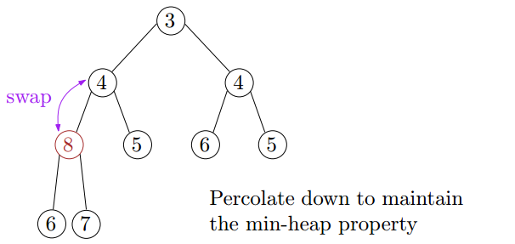
Extract-Min
Copy the last element to the root (i.e., overwrite the minimum element stored there)
Restore the min-heap property by percolate down (or bubble down): if the element is larger than either of its children, then interchange it with the smaller of its children.

Slide 36
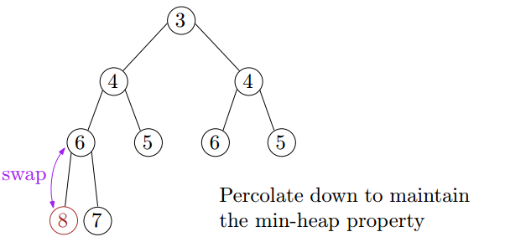
Extract-Min
Copy the last element to the root (i.e., overwrite the minimum element stored there)
Restore the min-heap property by percolate down (or bubble down): if the element is larger than either of its children, then interchange it with the smaller of its children.
Correctness: after each swap, the min-heap property is satisfied for all nodes except the node containing the element (with respect to its children)

Slide 37
Extract-Min
Copy the last element to the root (i.e., overwrite the minimum element stored there)
Restore the min-heap property by percolate down (or bubble down): if the element is larger than either of its children, then interchange it with the smaller of its children.
Correctness: after each swap, the min-heap property is satisfied for all nodes except the node containing the element (with respect to its children)
Time complexity = O(height) = O(log n)

Slide 38
Outline
Introduction to Part I
Heapsort Problem
Priority Queues
(Binary) Heap
Heapsort
Lower Bound for Comparison-based Sorting
Objective
Decision Tree Model

Slide 39
Heapsort
Build a binary heap of n elements
the minimum element is at the top of the heap

Slide 40
Heapsort
Build a binary heap of n elements
the minimum element is at the top of the heap
Perform n Extract-Min operations
the elements are extracted in sorted order

Slide 41
Heapsort
Build a binary heap of n elements
the minimum element is at the top of the heap
insert n elements one by one → O(n log n) (there is a more efficient way, check CLRS 6.3 if interested)
Perform n Extract-Min operations
the elements are extracted in sorted order

Slide 42
Heapsort
Build a binary heap of n elements
the minimum element is at the top of the heap
insert n elements one by one → O(n log n) (there is a more efficient way, check CLRS 6.3 if interested)
Perform n Extract-Min operations
the elements are extracted in sorted order
each Extract-Min operation takes O(log n) time → O(n log n)

Slide 43
Heapsort
Build a binary heap of n elements
the minimum element is at the top of the heap
insert n elements one by one → O(n log n) (there is a more efficient way, check CLRS 6.3 if interested)
Perform n Extract-Min operations
the elements are extracted in sorted order
each Extract-Min operation takes O(log n) time → O(n log n)
Total time complexity: O(n log n)

Slide 44
Heapsort - Example
Build a binary heap of n elements
4
1
3
2
16
9
10
14
8
7

Slide 45
Heapsort - Example
Build a binary heap of n elements
4
1
3
2
16
9
10
14
8
7
4

Slide 46
Heapsort - Example
Build a binary heap of n elements
4
1
3
2
16
9
10
14
8
7
4

Slide 47
Heapsort - Example
Build a binary heap of n elements
4
1
3
2
16
9
10
14
8
7
4
1

Slide 48
Heapsort - Example
Build a binary heap of n elements
1
4
3
2
16
9
10
14
8
7
1
4

Slide 49
Heapsort - Example
Build a binary heap of n elements
1
4
3
2
16
9
10
14
8
7
1
4

Slide 50
Heapsort - Example
Build a binary heap of n elements
1
4
3
2
16
9
10
14
8
7
1
4
3

Slide 51
Heapsort - Example
Build a binary heap of n elements
1
4
3
2
16
9
10
14
8
7
1
4
3

Slide 52
Heapsort - Example
Build a binary heap of n elements
1
4
3
2
16
9
10
14
8
7
1
4
3
2

Slide 53
Heapsort - Example
Build a binary heap of n elements
1
2
3
4
16
9
10
14
8
7
1
2
3
4

Slide 54
Heapsort - Example
Build a binary heap of n elements
1
2
3
4
16
9
10
14
8
7
1
2
3
4

Slide 55
Heapsort - Example
Build a binary heap of n elements
1
2
3
4
16
9
10
14
8
7
1
2
3
4
16

Slide 56
Heapsort - Example
Build a binary heap of n elements
1
2
3
4
16
9
10
14
8
7
1
2
3
4
16

Slide 57
Heapsort - Example
Build a binary heap of n elements
1
2
3
4
16
9
10
14
8
7
1
2
3
4
16
9

Slide 58
Heapsort - Example
Build a binary heap of n elements
1
2
3
4
16
9
10
14
8
7
1
2
3
4
16
9

Slide 59
Heapsort - Example
Build a binary heap of n elements
1
2
3
4
16
9
10
14
8
7
1
2
3
4
16
9
10

Slide 60
Heapsort - Example
Build a binary heap of n elements
1
2
3
4
16
9
10
14
8
7
1
2
3
4
16
9
10

Slide 61
Heapsort - Example
Build a binary heap of n elements
1
2
3
4
16
9
10
14
8
7
1
2
3
4
16
9
10
14

Slide 62
Heapsort - Example
Build a binary heap of n elements
1
2
3
4
16
9
10
14
8
7
1
2
3
4
16
9
10
14

Slide 63
Heapsort - Example
Build a binary heap of n elements
1
2
3
4
16
9
10
14
8
7
1
2
3
4
16
9
10
14
8

Slide 64
Heapsort - Example
Build a binary heap of n elements
1
2
3
4
16
9
10
14
8
7
1
2
3
4
16
9
10
14
8

Slide 65
Heapsort - Example
Build a binary heap of n elements
1
2
3
4
16
9
10
14
8
7
1
2
3
4
16
9
10
14
8
7

Slide 66
Heapsort - Example
Build a binary heap of n elements
1
2
3
4
7
9
10
14
8
16
1
2
3
4
7
9
10
14
8
16

Slide 67
Heapsort - Example
Build a binary heap of n elements
1
2
3
4
7
9
10
14
8
16
1
2
3
4
7
9
10
14
8
16

Slide 68
Heapsort - Example
Perform n Extract-Min operations
1
2
3
4
7
9
10
14
8
16

Slide 69
Heapsort - Example
Perform n Extract-Min operations
1
16
2
3
4
7
9
10
14
8

Slide 70
Heapsort - Example
Perform n Extract-Min operations
1
2
16
3
4
7
9
10
14
8

Slide 71
Heapsort - Example
Perform n Extract-Min operations
1
2
4
3
16
7
9
10
14
8

Slide 72
Heapsort - Example
Perform n Extract-Min operations
1
2
4
3
8
7
9
10
14
16

Slide 73
Heapsort - Example
Perform n Extract-Min operations
1
2
4
3
8
7
9
10
14
16

Slide 74
Heapsort - Example
Perform n Extract-Min operations
1
2
16
4
3
8
7
9
10
14

Slide 75
Heapsort - Example
Perform n Extract-Min operations
1
2
3
4
16
8
7
9
10
14

Slide 76
Heapsort - Example
Perform n Extract-Min operations
1
2
3
4
9
8
7
16
10
14

Slide 77
Heapsort - Example
Perform n Extract-Min operations
1
2
3
4
9
8
7
16
10
14

Slide 78
Heapsort - Example
Perform n Extract-Min operations
1
2
3
14
4
9
8
7
16
10

Slide 79
Heapsort - Example
Perform n Extract-Min operations
1
2
3
4
14
9
8
7
16
10

Slide 80
Heapsort - Example
Perform n Extract-Min operations
1
2
3
4
7
9
8
14
16
10

Slide 81
Heapsort - Example
Perform n Extract-Min operations
1
2
3
4
7
9
8
14
16
10

Slide 82
Heapsort - Example
Perform n Extract-Min operations
1
2
3
4
10
7
9
8
14
16

Slide 83
Heapsort - Example
Perform n Extract-Min operations
1
2
3
4
7
10
9
8
14
16

Slide 84
Heapsort - Example
Perform n Extract-Min operations
1
2
3
4
7
8
9
10
14
16

Slide 85
Heapsort - Example
Perform n Extract-Min operations
1
2
3
4
7
8
9
10
14
16

Slide 86
Heapsort - Example
Perform n Extract-Min operations
1
2
3
4
7
16
8
9
10
14

Slide 87
Heapsort - Example
Perform n Extract-Min operations
1
2
3
4
7
8
16
9
10
14

Slide 88
Heapsort - Example
Perform n Extract-Min operations
1
2
3
4
7
8
10
9
16
14

Slide 89
Heapsort - Example
Perform n Extract-Min operations
1
2
3
4
7
8
10
9
16
14

Slide 90
Heapsort - Example
Perform n Extract-Min operations
1
2
3
4
7
8
14
10
9
16

Slide 91
Heapsort - Example
Perform n Extract-Min operations
1
2
3
4
7
8
9
10
14
16

Slide 92
Heapsort - Example
Perform n Extract-Min operations
1
2
3
4
7
8
9
10
14
16

Slide 93
Heapsort - Example
Perform n Extract-Min operations
1
2
3
4
7
8
9
16
10
14

Slide 94
Heapsort - Example
Perform n Extract-Min operations
1
2
3
4
7
8
9
10
16
14

Slide 95
Heapsort - Example
Perform n Extract-Min operations
1
2
3
4
7
8
9
10
16
14

Slide 96
Heapsort - Example
Perform n Extract-Min operations
1
2
3
4
7
8
9
10
14
16

Slide 97
Heapsort - Example
Perform n Extract-Min operations
1
2
3
4
7
8
9
10
14
16

Slide 98
Heapsort - Example
Perform n Extract-Min operations
1
2
3
4
7
8
9
10
14
16

Slide 99
Heapsort - Example
Perform n Extract-Min operations
1
2
3
4
7
8
9
10
14
16

Slide 100
Heapsort - Example
Perform n Extract-Min operations
1
2
3
4
7
8
9
10
14
16

Slide 101
Heapsort - Example
Perform n Extract-Min operations
1
2
3
4
7
8
9
10
14
16

Slide 102
Summary
Priority queue is an abstract data structure that supports two operations: Insert and Extract-Min.

Slide 103
Summary
Priority queue is an abstract data structure that supports two operations: Insert and Extract-Min.
If priority queues are implemented using heaps, then these two operations are supported in O(log n) time.

Slide 104
Summary
Priority queue is an abstract data structure that supports two operations: Insert and Extract-Min.
If priority queues are implemented using heaps, then these two operations are supported in O(log n) time.
Heapsort takes O(n log n) time, which is as efficient as merge sort and quicksort.

Slide 105
Outline
Introduction to Part I
Heapsort Problem
Priority Queues
(Binary) Heap
Heapsort
Lower Bound for Comparison-based Sorting
Objective
Decision Tree Model

Slide 106
Objective
All sorting algorithms seen so far are based on comparing elements
E.g., insertion sort, merge sort, and heapsort

Slide 107

Objective
All sorting algorithms seen so far are based on comparing elements
E.g., insertion sort, merge sort, and heapsort
Insertion sort has worst-case running time Θ(n²), while the others have worst-case running time $Θ(n log⁡n)$

Slide 108
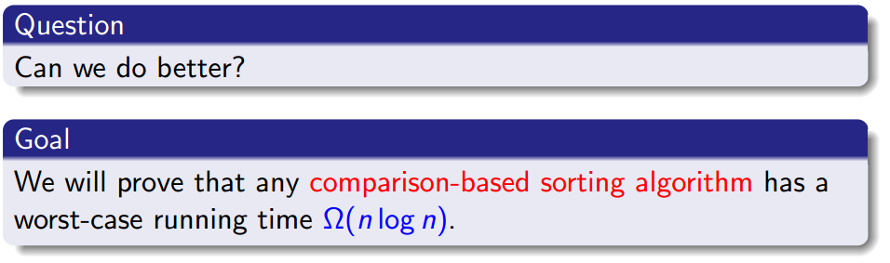
Objective
All sorting algorithms seen so far are based on comparing elements
E.g., insertion sort, merge sort, and heapsort
Insertion sort has worst-case running time Θ(n²), while the others have worst-case running time $Θ(n log⁡n)$

Slide 109
Objective
All sorting algorithms seen so far are based on comparing elements
E.g., insertion sort, merge sort, and heapsort
Insertion sort has worst-case running time Θ(n²), while the others have worst-case running time $Θ(n log⁡n)$

Slide 110
Outline
Introduction to Part I
Heapsort Problem
Priority Queues
(Binary) Heap
Heapsort
Lower Bound for Comparison-based Sorting
Objective
Decision Tree Model

Slide 111
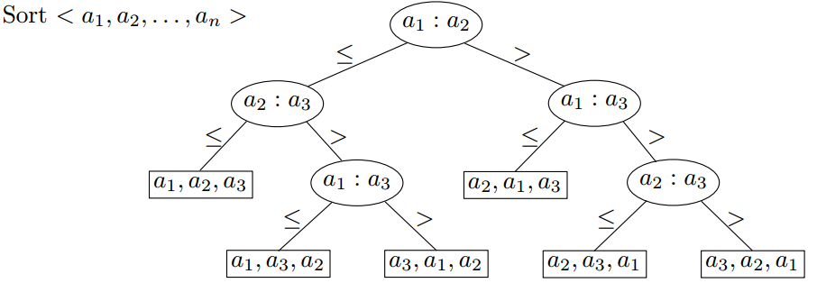
Decision-tree Model

Slide 112
Decision-tree Model
Each internal node is labeled a_{i} : a_{j} for {1,2,…,n}

Slide 113
Decision-tree Model
Each internal node is labeled a_{i} : a_{j} for {1,2,…,n}
The left subtree shows subsequent comparisons if a_{i} ≤ a_{j}

Slide 114
Decision-tree Model
Each internal node is labeled a_{i} : a_{j} for {1,2,…,n}
The left subtree shows subsequent comparisons if a_{i} ≤ a_{j}
The right subtree shows subsequent comparisons if a_{i} > a_{j}

Slide 115
Decision-tree Model
Each internal node is labeled a_{i} : a_{j} for {1,2,…,n}
The left subtree shows subsequent comparisons if a_{i} ≤ a_{j}
The right subtree shows subsequent comparisons if a_{i} > a_{j}
Each leaf corresponds to an input ordering

Slide 116
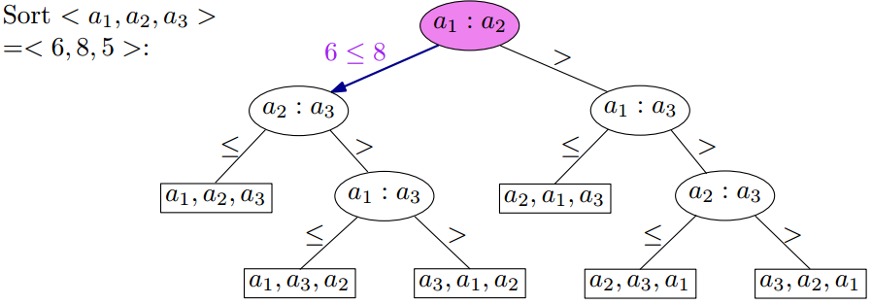
Decision-tree Model
Each internal node is labeled a_{i} : a_{j} for {1,2,…,n}
The left subtree shows subsequent comparisons if a_{i} ≤ a_{j}
The right subtree shows subsequent comparisons if a_{i} > a_{j}
Each leaf corresponds to an input ordering

Slide 117
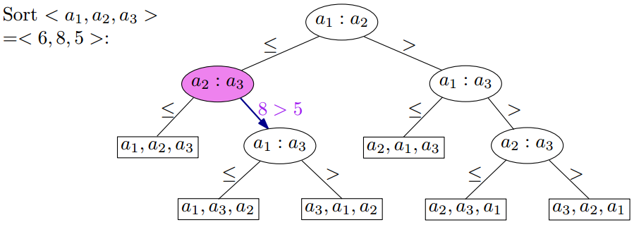
Decision-tree Model
Each internal node is labeled a_{i} : a_{j} for {1,2,…,n}
The left subtree shows subsequent comparisons if a_{i} ≤ a_{j}
The right subtree shows subsequent comparisons if a_{i} > a_{j}
Each leaf corresponds to an input ordering

Slide 118
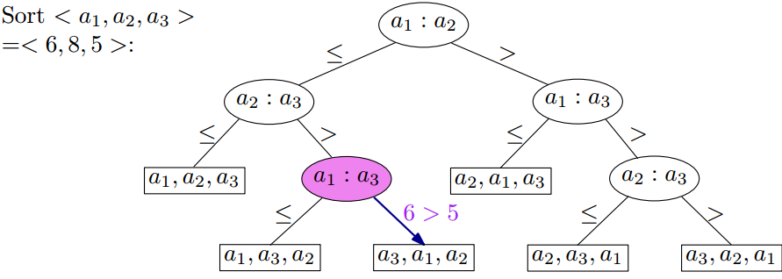
Decision-tree Model
Each internal node is labeled a_{i} : a_{j} for {1,2,…,n}
The left subtree shows subsequent comparisons if a_{i} ≤ a_{j}
The right subtree shows subsequent comparisons if a_{i} > a_{j}
Each leaf corresponds to an input ordering

Slide 119
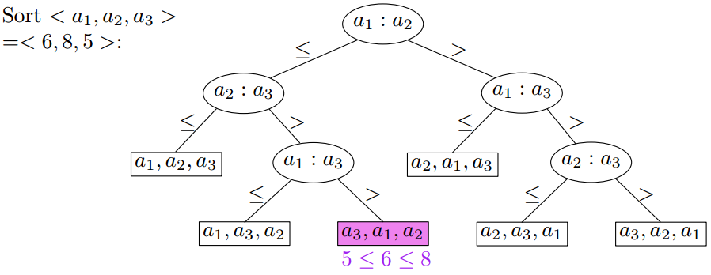
Decision-tree Model
Each internal node is labeled a_{i} : a_{j} for {1,2,…,n}
The left subtree shows subsequent comparisons if a_{i} ≤ a_{j}
The right subtree shows subsequent comparisons if a_{i} > a_{j}
Each leaf corresponds to an input ordering

Slide 120
Decision-tree Model
A decision tree can model the execution of any comparison-based sorting algorithm

Slide 121
Decision-tree Model
A decision tree can model the execution of any comparison-based sorting algorithm
One tree for each input size n

Slide 122
Decision-tree Model
A decision tree can model the execution of any comparison-based sorting algorithm
One tree for each input size n
Worst-case running time = height of tree

Slide 123
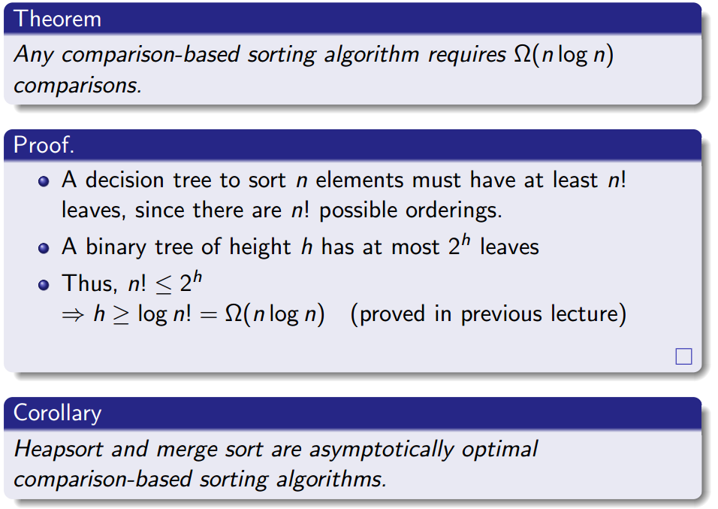
Lower Bound for Sorting

Slide 124
Lower Bound for Sorting

Slide 125
Lower Bound for Sorting

Slide 126
Lower Bound for Sorting

Slide 127
Lower Bound for Sorting

Slide 128
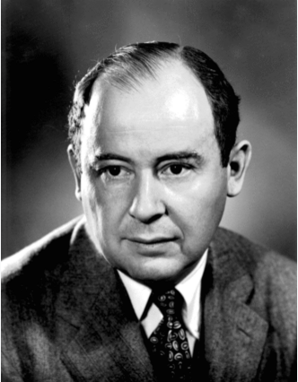


Summary
John von Neumann
Merge Sort Algorithm
was invented in 1945
Tony Hoare
Quicksort Algorithm
was invented in 1959
J. W. J. Williams
Heapsort Algorithm
was invented in 1964
Which algorithm is the best in practice?

Slide 129


